Slide 1
ACTIVITY ON ENERGY SYSTEMS ASSESMENT AND MODELING
Jeffrey Cepedoza, MSEE
Ivan John Naparota, MSEE

Slide 2
GEOGRAPHICAL INFORMATION SYSTEM
Its applications on energy and environment sustainability

Slide 3
Agenda
To be able to answer the following questions:
What is Geographical Information System?
What is Energy Sustainability?
How does GIS contribute to solving Energy Sustainability issues?
What is Environmental Sustainability?
How does GIS contribute to solving Environmental Sustainability issues?

Slide 4
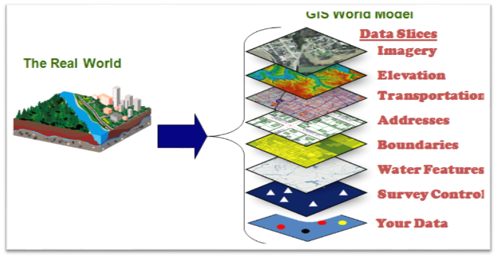
Geographical Information System
Geographical Information System(GIS) is a computer-based system that provides the following four sets of capabilities to handle geo-referenced data:

Slide 5
Data capture and preparation
Data management, including storage and maintenance
Data manipulation and analysis
Data presentation
This implies that GIS user can expect support from the system to enter (geo referenced) data, to analyse it in various ways , and to produce presentations (including maps and other types) from the data [1].

Slide 6
GIS have rapidly developed since the late 1970’s in terms of both technical and processing capabilities, and are widely used today all over the world for a wide range of purposes, could be useful for urban planners, biologists, natural hazard analyst, forest manager, and in different disciplines of engineers [1].

Slide 7

What is sustainable energy?
As commonly defined, sustainable energy is an energy system that serves the needs of the present without compromising the ability of future generations to meet their needs [2].

Slide 8
In other words, sustainable energy is the continuous availability of energy sources that will cater the world’s continuing needs without sacrificing the world’s natural resources.

Slide 9


Energy management has become one of the main challenges for all countries in the world. The economical and human development require a significant quantity of energy. However, this economic growth is often combined with the increase of greenhouse gas emissions [4].

Slide 10
Greenhouse gases concentrations have risen over the last 250 years from greater fossil fuel use, modern wide-scale agriculture, and land use alteration [5]
The development of renewable sources of energy is crucial to limit carbon emissions responsible for the global warming [6]

Slide 11

GIS on Renewable Energy
GIS has become a critical planning and management tool for addressing where and how to enable sustainable energy efforts like exploring a switch to renewable energy sources.

Slide 12
A Geographical Information System Approach for Analysis of Surface Areas in the Context of Renewable Energy Resources
A research authored by Alexandre Oudin, David Sprake, Yuriy Vagapov, and Olga Simonova
Website: http://ieeexplore.ieee.org/document/7910604/

Slide 13
Generally, it’s a research that uses layered GIS of United Kingdom's lands to compare Renewable Energy Sources technical potential, and at the same time investigates a way to combine different renewables in a three dimensional study of the area, to harness renewable energy from ground (solar and bioenergy) to altitude (wind energy) and underground (geothermal), to maximize land's potential for renewable energy source.

Slide 14
GIS Decision Model for Global Replication of Hybrid Closed-loop Renewable Energy Systems
A research authored by Cory R. A. Hallam, Luis Alarco, William Flannery, Anita Leffel
Website: http://ieeexplore.ieee.org/document/6304301/

Slide 15
To alleviate the dependence on generating plants that depend on external supplies of fossil fuels and significantly reduce the carbon footprint by reducing the effective combustion by products, this research uses Geographical Information System to locate and analyse what is the best possible renewable energy to create in a larger geographically isolated population that do not have access to the grid. The test area for this research is El Hierro Island, a remote island somewhere in Spain.

Slide 16
Prioritization Decision for Renewable Energy Development Using Analytic Hierarchy Process and Geographic Information System
A research authored by Meita Rumbayan and Ken Nagasaka
Website: http://ieeexplore.ieee.org/document/6329677/

Slide 17
In this study, the resource of renewable energy potential for entire Indonesia has been investigated with the help of GIS Technology, with the objective to find suitable sites for prioritizing renewable energy development, based on data available regarding theoretical potential of solar, wind and geothermal energy.
The result of the study found that geothermal is the best choice, followed by solar and wind alternatives.

Slide 18
Generalization on GIS to Energy Relationship
After reviewing those different literatures, Geographical Information System (GIS), as a tool for analysing geographical features is of great help on taking a step for noble efforts to address Energy Sustainability issues. It is very useful in planning for renewable energy sources in a particular location, taking into account the potential of an area and its suitability to a certain renewable energy source.

Slide 19

What is Environmental Sustainability?
A state in which the demands placed on the environment can be met without reducing its capacity to allow all people to live well, now and in the future [3].

Slide 20

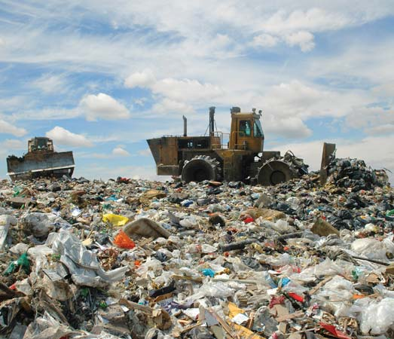
As the world strives for development, environment is somewhat taken for granted indirectly. When in fact, the world is facing rapid climate change according to https://climate.nasa.gov/evidence/, evidences like global temperature rise, warming oceans, shrinking ice sheets, glacial retreat, decreased snow cover, sea level rise, declining arctic sea ice, extreme events (intense rainfall increase), ocean acidification.

Slide 21

And without everyone’s effort, these problems will eventually be very overwhelming concerns for the world.

Slide 22
GIS on Environmental Sustainability
“A Review of Solid Waste Management Techniques using GIS and Other Technologies”
Authored by: Priyanka Shrivastava, Shivangi Mishra, and S.K.Katiyar
Website: http://ieeexplore.ieee.org/document/7546339/

Slide 23
This paper which is based in a particular place in India believes that there has to be appropriate planning for proper waste management by analyzing the area and its waste situation. The paper uses Geographical Information System and other technologies like RFID, GPS etc. to make an innovative approach for planning and management of the solid waste.

Slide 24
“An Application of Geographic Information System for Locating Sanitary Landfill Sites: A Case Study of Bangkok”
Author: Warot Kiettitanabumroong, Garavig Tanaksaranond, Pisit Jarumaneeroj
Website: http://ieeexplore.ieee.org/document/7939207/

Slide 25
With the use of GIS based mathematical model, this paper provides a systematic framework for locating new sanitary landfills in Bangkok in order to better utilize(in the form of Bio-Energy) the increasing amount of Municipal Solid Waste over the next 20 years.

Slide 26
“Rural Development Studies And Geographical Information Systems”
Author: Hakan ERDEN, İbrahim Aykut KAYA, Mine ÖCAL
Website: http://ieeexplore.ieee.org/document/7248097/

Slide 27
The study is all about deciding on the area and location to be invested on and the form of the investment, deciding on the product and alternative product, providing the determination of the road areas, soil data supported shortest road area planning are some of the factors considered. GIS plays an important role in getting a precise and accurate data in order for the decision making to avoid some fatal errors in selecting the rural areas to be developed.

Slide 28
Generalizations on GIS to Environment Relationship
Positive
Negative
Geographical Information System (GIS ), as a tool, depending on the way it’s used, could be of great help on addressing environmental sustainability issues, in solid waste management in particular, by analyzing the area and its waste situation.
GIS could also be used for industrialization agenda, and undeniably, industrialization indirectly contribute to environmental degradation.

Slide 29
REFERENCES
https://www.itc.nl/library/papers_2009/general/principlesgis.pdf
Renewable Energy & Efficiency Partnership (August 2004). "Glossary of terms in sustainable energy regulation" (PDF).
http://lexicon.ft.com/Term?term=environmental-sustainability
IEA, “Energy statistics manual,” International Energy Agency, 2013. [Online]. Available: https://www.iea.org/publications/freepublications/publication/statistics_manual.pdf

Slide 30
5. Solomon S, Qin D, Manning M, Alley RB, Berntsen T, Bindoff NL, et al. Technical summary. In: Solomon S, Qin D, Manning M, Chen Z, Marquis M, Averyt KB, et al., editors. Climate change 2007: the physical science basis. Contribution ofWorking Group I to the fourth assessment report of the intergovernmental panel on climate change. New York, NY: Cambridge University Press; 2007. p. 74.
6. M. Bilgili, A. Ozbek, B. Sahin, A. Kahraman. “An overview of renewable electric power capacity and progress in new technologies in the world,” Renewable and Sustainable Energy Review, vol. 49, pp.323–334

